Slide 1
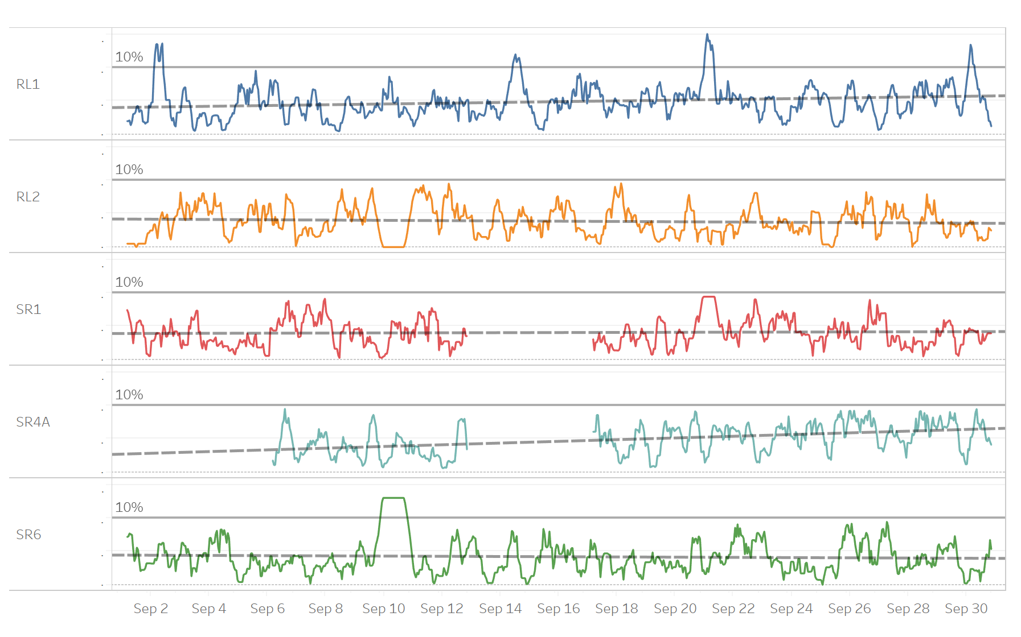
Coal Terminal Maintenance Analysis
Executive Summary

Slide 2
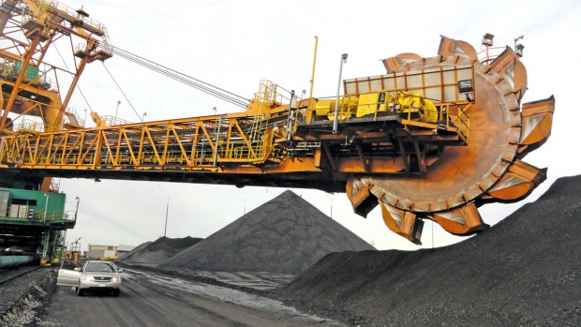
Background Story: Reclaimer

Slide 3
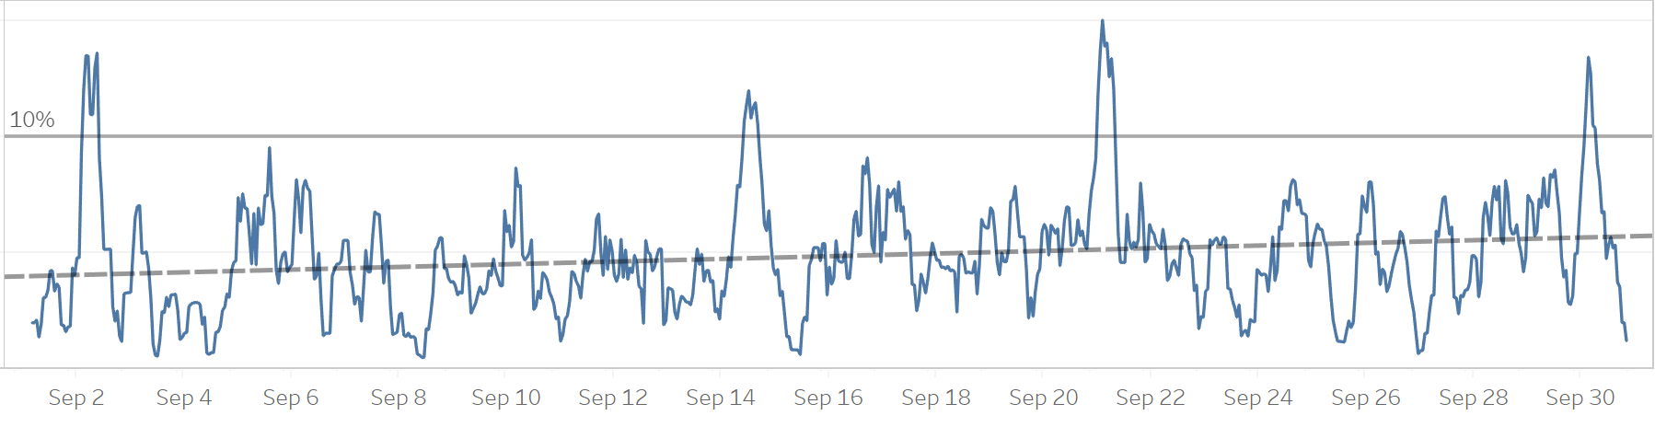
Analysis - RL1
- The image above illustrates the 8-hour moving average of idle capacity for Reclaimer 1 expressed as a
percentage of nominal capacity
- Through out the month RL1 exceeded the allowable threshold multiple times on 2/9, 14/9 and 21/9.
- In addition, the data shows upward trend in the unused capacity of this machine. It is evident that this
Machine requires maintenance in the upcoming month.

Slide 4
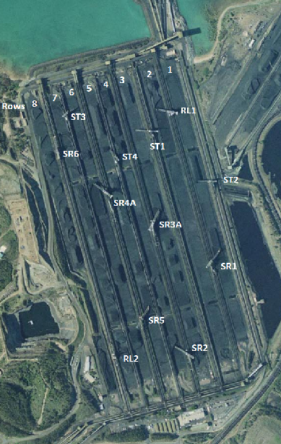
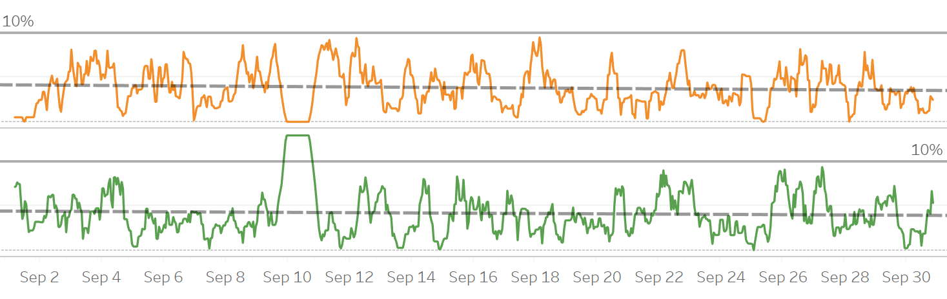
Analysis - RL2 & SR6
⚪
- The image above illustrates the 8-hour moving average of idle capacity for RL2 and SR6. The trend line shows they both operate normally.
- Despite there is an exceed in SR6, it could be caused on purpose. Because RL2 and SR6 are in the same line and there is a trough in RL2 at the same time.
⚪

Slide 5
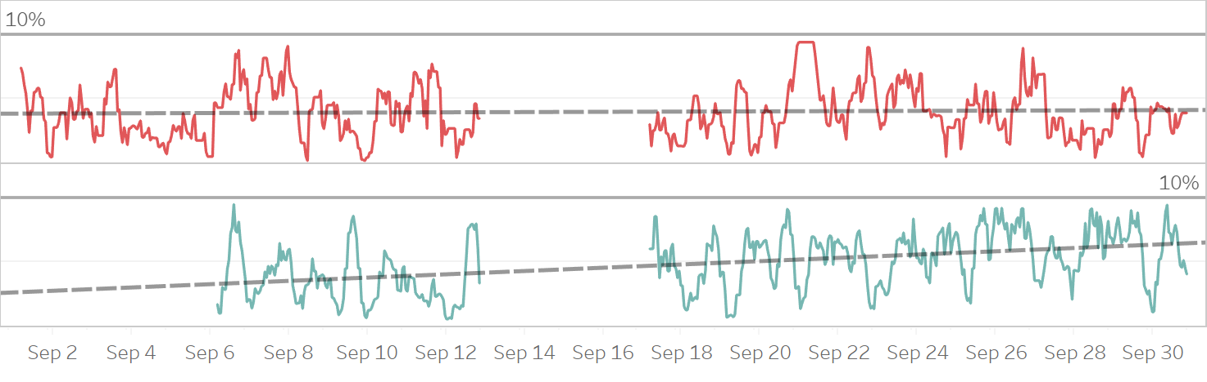
Analysis – SR1 & SR4A
- SR1 and SR4A both didn’t exceed any time last month.
- But for SR4A, though there was no exceed last month, yet the trend line indicates that the machine didn’t operate normally and perhaps we should consider it being maintained in the upcoming month.

Slide 6
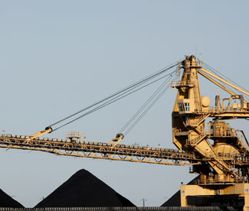
Thanks
Presented by Jason Z

